Slide 1
Science- Chapter 8
Atoms & Elements

Slide 2
More Vocabulary
Quick Questions
More Quick Questions
Vocabulary
Explanations
100
100
100
100
100
200
200
200
200
200
300
300
300
300
300
400
400
400
400
400
500
500
500
500
500

Slide 3
Vocabulary– 100
A small, positively charged particle

Slide 4
100
proton

Slide 5
Vocabulary- 200
The structure at the center of an atom

Slide 6
200
nucleus

Slide 7
Vocabulary- 300
The smallest particle of an element that still has the properties of that element

Slide 8
300
atom

Slide 9
Vocabulary- 400
Elements are shown arranged by their properties in a chart called the what?

Slide 10
400
periodic table

Slide 11
Vocabulary- 500
The abbreviation of an element’s name

Slide 12
500
chemical symbol

Slide 13
More Vocabulary- 100
A negatively charged particle that is a part of an atom

Slide 14
100
electron

Slide 15
More Vocabulary- 200
An element that hardly ever combines with other elements to form a compound

Slide 16
200
noble gas

Slide 17
More Vocabulary- 300
A substance that cannot be broken apart chemically into other substances

Slide 18
300
element

Slide 19
More Vocabulary- 400
An element that can be bent or stretched and is usually shiny

Slide 20
400
metal

Slide 21
More Vocabulary- 500
A pure substance made of two or more elements that are chemically combined

Slide 22
500
compound

Slide 23
Quick Questions- 100
What are the three groups into which elements can be classified based on their properties?

Slide 24
100
Metals, nonmetals, and semimetals

Slide 25
Quick Questions- 200
Which particles in an atom contribute most to the mass of an atom?

Slide 26
200
protons and neutrons

Slide 27
Quick Questions- 300
What is true about the elements in a given column of the periodic table?

Slide 28
300
All elements in a column of the periodic table have similar properties

Slide 29
Quick Questions- 400
What is a molecule?

Slide 30
400
A molecule is a group of two or more atoms that are chemically joined and act as a single unit

Slide 31
Quick Questions- 500
What does periodic mean

Slide 32
500
happening at regular times

Slide 33
Explanations- 100
If the atomic number of an element is 26, what else can you learn from this information?

Slide 34
100
There are 26 protons in the nucleus.
It also has 26 electrons circling the nucleus

Slide 35
Explanations- 200
What doesn’t water have a place on the periodic table?

Slide 36
200
Water is not an element, it is a compound made up of hydrogen and oxygen (which are both located on the periodic table)

Slide 37
Explanations- 300
Why is carbon so important to all living things?

Slide 38
300
Carbon compounds are the main parts of all living things

Slide 39
Explanations- 400
You classified a material as a metal; however, your partner has some doubts. How would you handle this situation?

Slide 40
400
Answers will vary

Slide 41
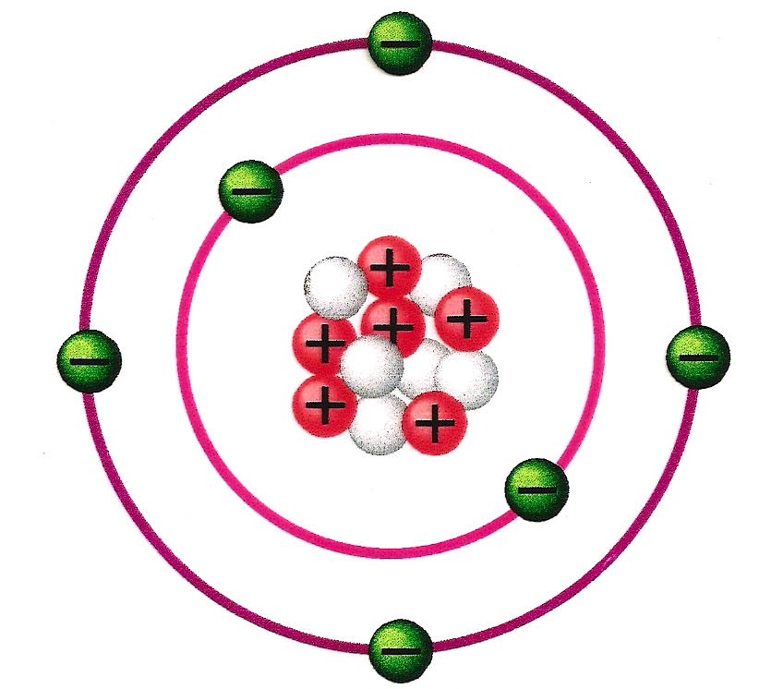
Explanations- 500
How many electrons circle the nucleus?

Slide 42
500
Six

Slide 43
More Quick Questions- 100
What is matter

Slide 44
100
Something that has mass and takes up space

Slide 45
More Quick Questions- 200
What makes up matter

Slide 46
200
atoms

Slide 47
More Quick Questions- 300
What is formed when atoms are combined

Slide 48
300
molecule

Slide 49
More Quick Questions- 400
What element is a building block of matter in living things

Slide 50
400
carbon

Slide 51
More Quick Questions- 500
What is the smallest number of parts in a compound

Slide 52
500
two

